Slide 1
Hand Gesture Recognition and Classification using Convolutional Neural Network
030873542

Slide 2
CONTENTS OF THIS TEMPLATE
Introduction | Introduction to Gesture Recognition Project
Dataset | What Dataset will be provided to fit the model ?
Data Preprocessing | Which data pre-processing techniques are involved
Model Architecture | What Architecture does CNN follows and configurations
Training Process & Evaluation | Steps Involved in training the CNN model
Results | Accuracy and Predictions of the model

Slide 3
INTRODUCTION
Hand gesture recognition has emerged as a crucial area of research with applications spanning from sign language interpretation to human-computer interaction. In recent years, Convolutional Neural Networks (CNNs) have demonstrated remarkable success in image recognition tasks, making them a natural choice for the complex task of understanding and classifying hand gestures. In this presentation, we explore the potential of CNNs in accurately recognizing and classifying hand gestures, paving the way for intuitive and efficient human-computer interaction systems.

Slide 4
TABLE OF CONTENTS
01
02
03
04
CREATE_GESTURE
LOAD_IMAGES
takes the input from User and creates the folder
responsible to load images and split them.
CNN_KERAS
RECOGNIZE_GESTURE
designed to train model using keras library
recognize hand gesture using pre-trained CNN model

Slide 5
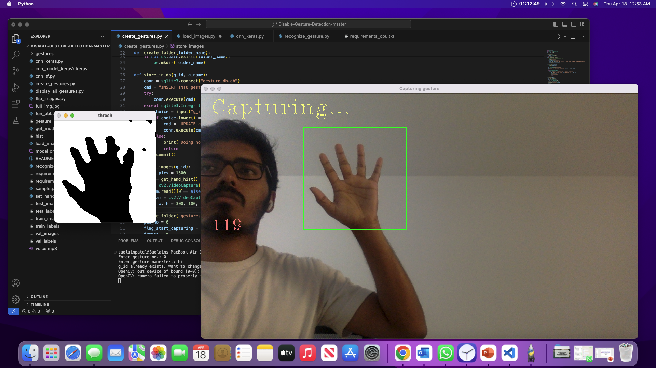
01 CREATE_GESTURE
get_hand_hist
init_create_folder_database
create_folder
store_in_dbstore_images
Thresh is used to isolate the hand region from the background in the captured video frames.

Slide 6






02 LOAD_IMAGES
train_images
train_labels
test_images
Subsets of images from dataset for training
Contains corresponding labels or categories for the training images
Subsets of images for evaluating the trained model
test_labels
val_images
val_labels
contains the corresponding labels for the test images
These are images set aside for model validation
Corresponding labels for the validation images

Slide 7
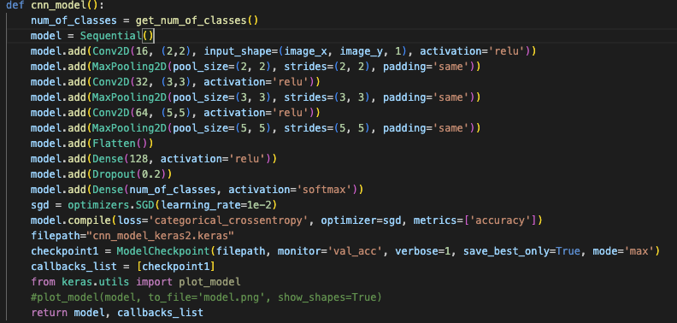
03 CNN_KERAS
1. Define Output Classes: the function begins by determining the number of output classes for the CNN using a function called get_num_of_classes().
2. Sequential models in Keras allow you to create models layer-by-layer in a step-by-step fashion.
It adds a 2D convolutional layer with 16 filters of size 2x2. This is the first layer, and it also defines the input shape of the data. Then it adds a max pooling layer that reduces the spatial dimensions by half.
3. This process is repeated two more times with increasing numbers of filters (32 and then 64), and different sizes of filters (3x3 and then 5x5) for extracting features at various scales.
4. Flatten the Output: After the convolutional and pooling layers, the model adds a Flatten layer, which converts the 2D matrix data to a vector.
5. Add dense Layers: A dense layer with 128 neurons is added to allow the network to learn non-linear combinations of features.
A dropout layer is then inserted to help prevent overfitting.
6. Output Layer: A final dense layer is added with a number of neurons corresponding to the number of output classes, with a SoftMax activation function that turns the network's outputs into probabilities.
7. Compile the Model: The model is then compiled with the Stochastic Gradient Descent (SGD) optimizer, a learning rate of 0.01.
8. Set Up Model Checkpoints: A checkpoint is set up to save the model at the best epoch

Slide 8
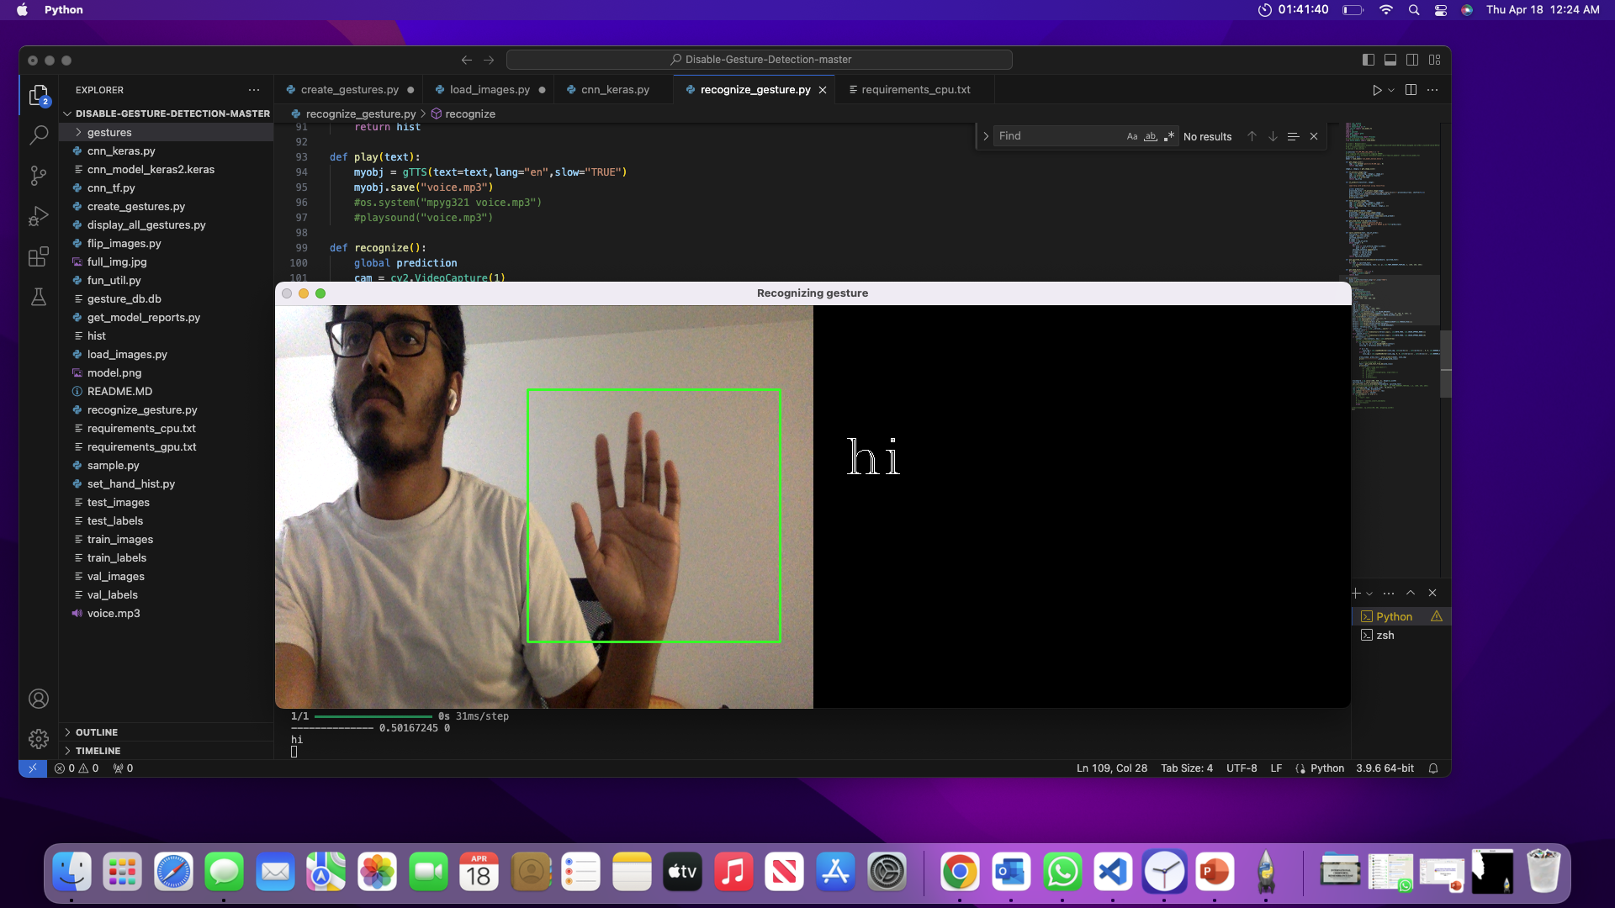
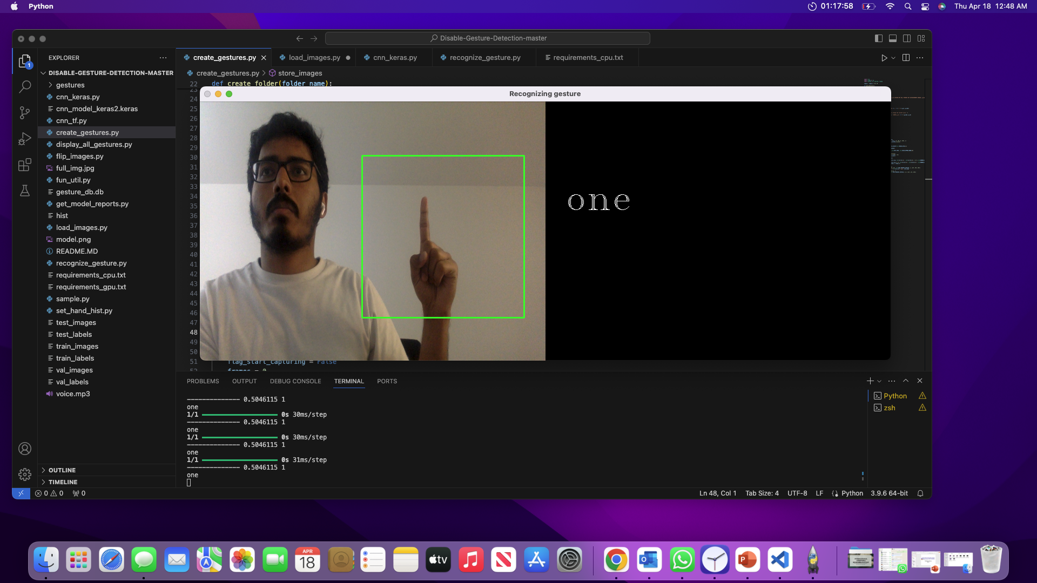
04 RECOGNIZE_GESTURE
When we present the neural network with the five-finger gesture, which it has been trained to interpret as a greeting, it should respond by recognizing it as such and outputting the friendly word 'hi'.

Slide 9
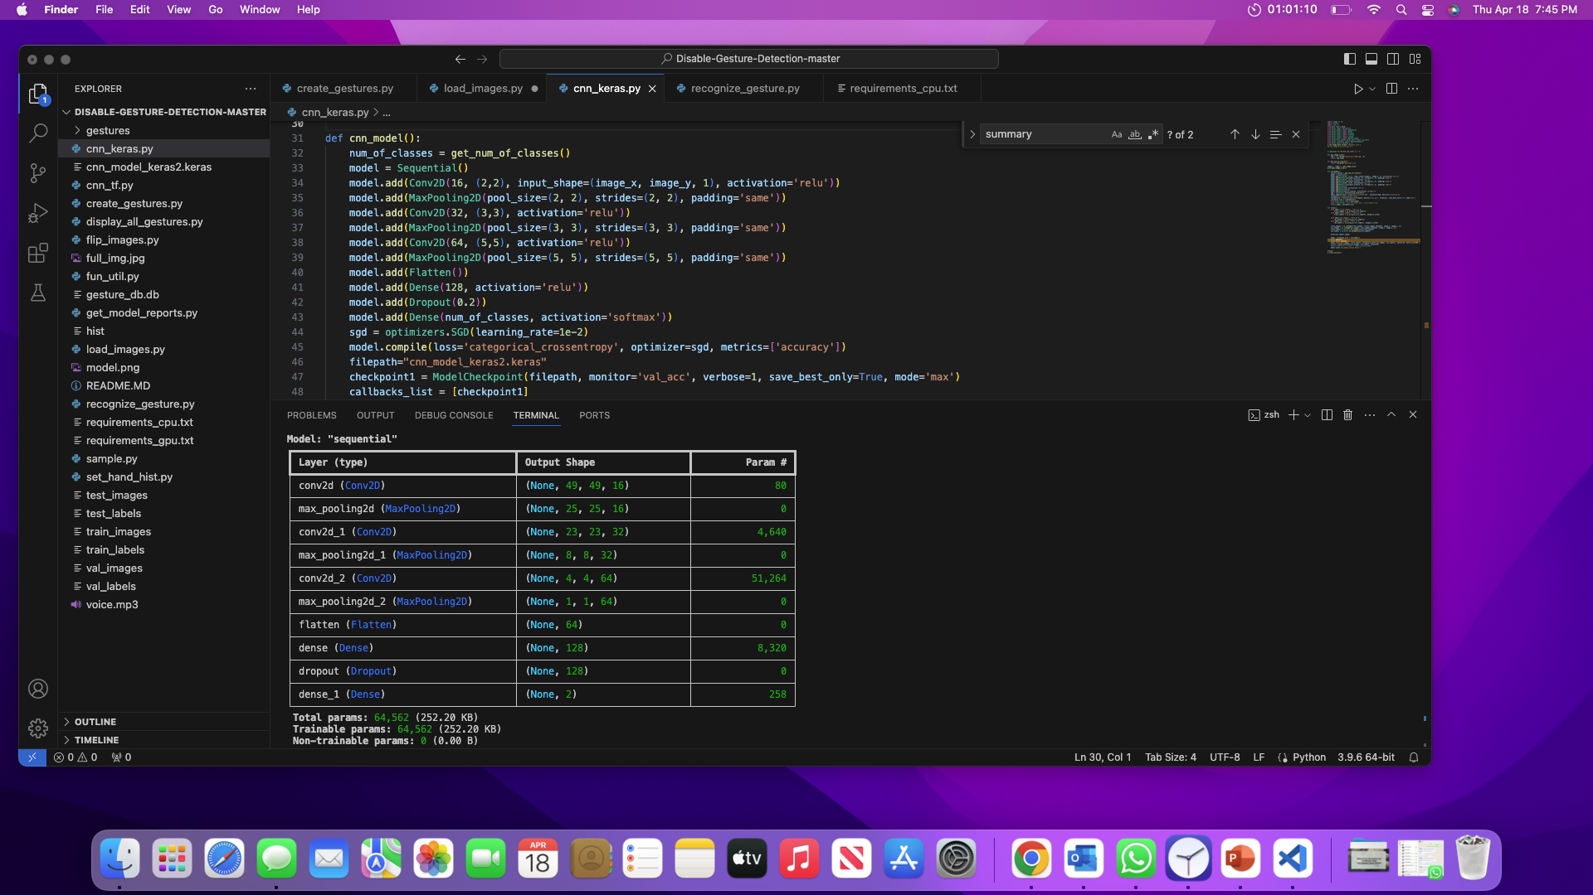
MODEL_SUMMARY

Slide 10
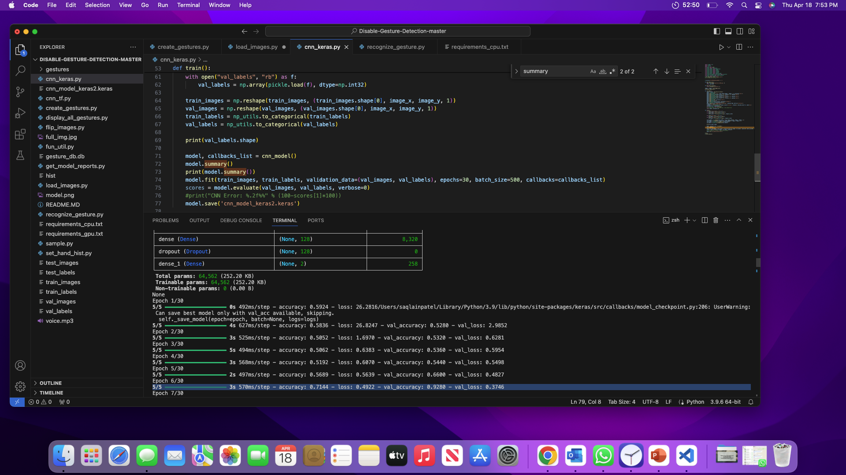
RESULTS
570ms/step - accuracy: 0.7144 - loss: 0.4922 - val_accuracy: 0.9280 - val_loss: 0.3746

Slide 11
CONCLUSION
In conclusion, the development of a hand gesture recognition system represents a significant advancement in human-computer interaction. Through the utilization of machine learning algorithms and computer vision techniques, we have successfully trained a neural network to interpret various hand gestures accurately. This technology holds immense potential in a wide range of applications, including sign language translation, virtual reality interactions, and gesture-based control systems. However, challenges such as real-time processing and robustness in diverse environments remain areas for further improvement.

